Slide 1
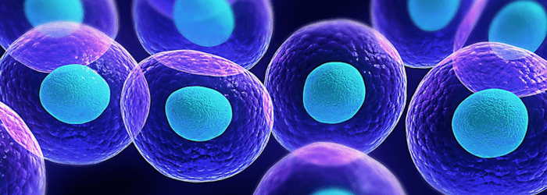
STEM CELLS
Fertilization produces the zygote. This cell undergoes mitosis to form stem cells that make up the blastocyst. Each stem cell can differentiate into whatever type of cell the body might need.
We can take this embryo out – is this murder? - and use its stem cells to treat brain diseases.
We can also take stem cells out of umbilical cord once a baby is born, for later use.

Slide 2
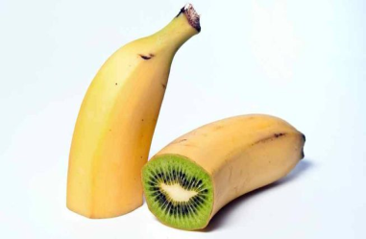
Genetically Modified (GMO) FOODS
ADVANTAGES
DISADVANTAGES
Resistant to pest & disease.
Tolerates herbicides, cold, droughts, soil salinity.
Contain extra food value.
Can include edible vaccines.
Sheep milk can be made to contain proteins for bad bleeding (haemophilia).
Long-term results are unknown – Dolly aged fast.
They might out-compete plants around us.
Allergies might develop - our bodies cannot control.
Bacteria in our intestines not adapted for new plans.

Slide 4
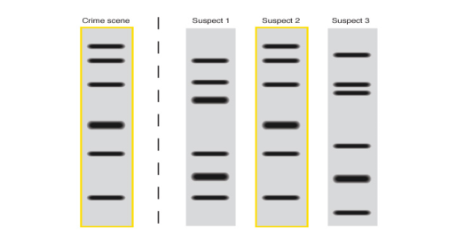
OTHER GENETIC REFERENCES
Page 5 showed about DNA Profiling. The child’s genetic characteristics shown in this way can be compared with those of both parents. The true father can now be identified from this.
Page 100 links with Evolution. Every human female in the last 150 000 years has had a DNA in their mitochondria that came from one female ancestor. (Scientists call her Mitochondrial Eve.)
All men in the last 50 000 years have a genetic marker on their Y-chromosome from one man.

